Slide 1

Project Proposal
Team7

Slide 2

1.Background
Index
2.Project Overview
3.Development plans
4.Expected Benefits

Slide 3

#01
Background

Slide 4

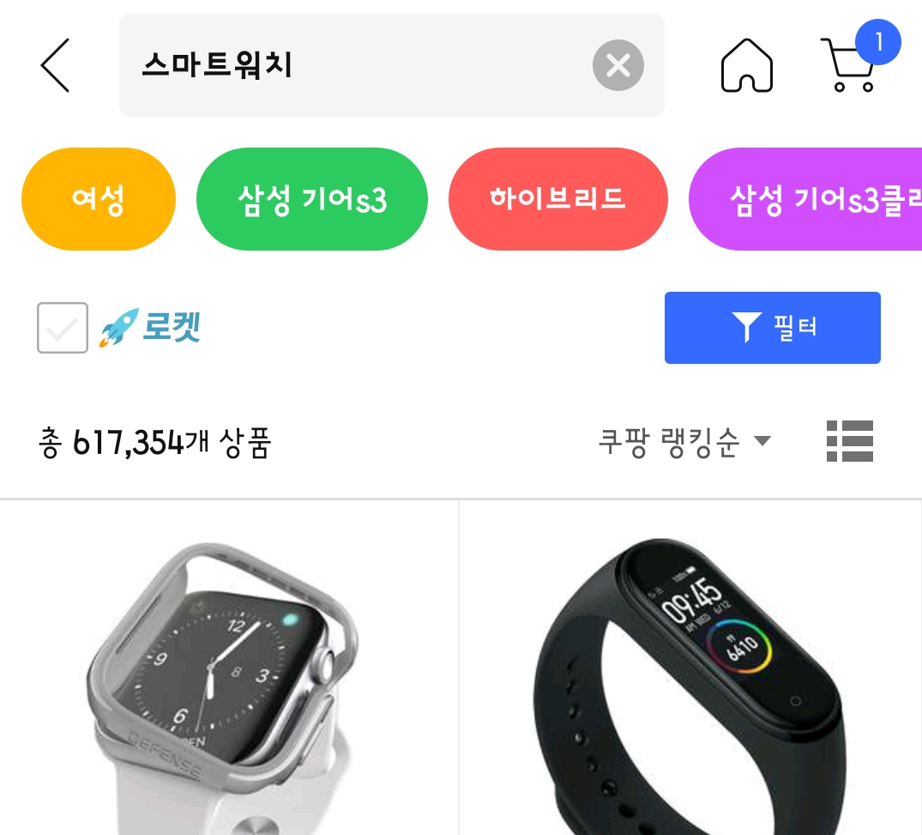
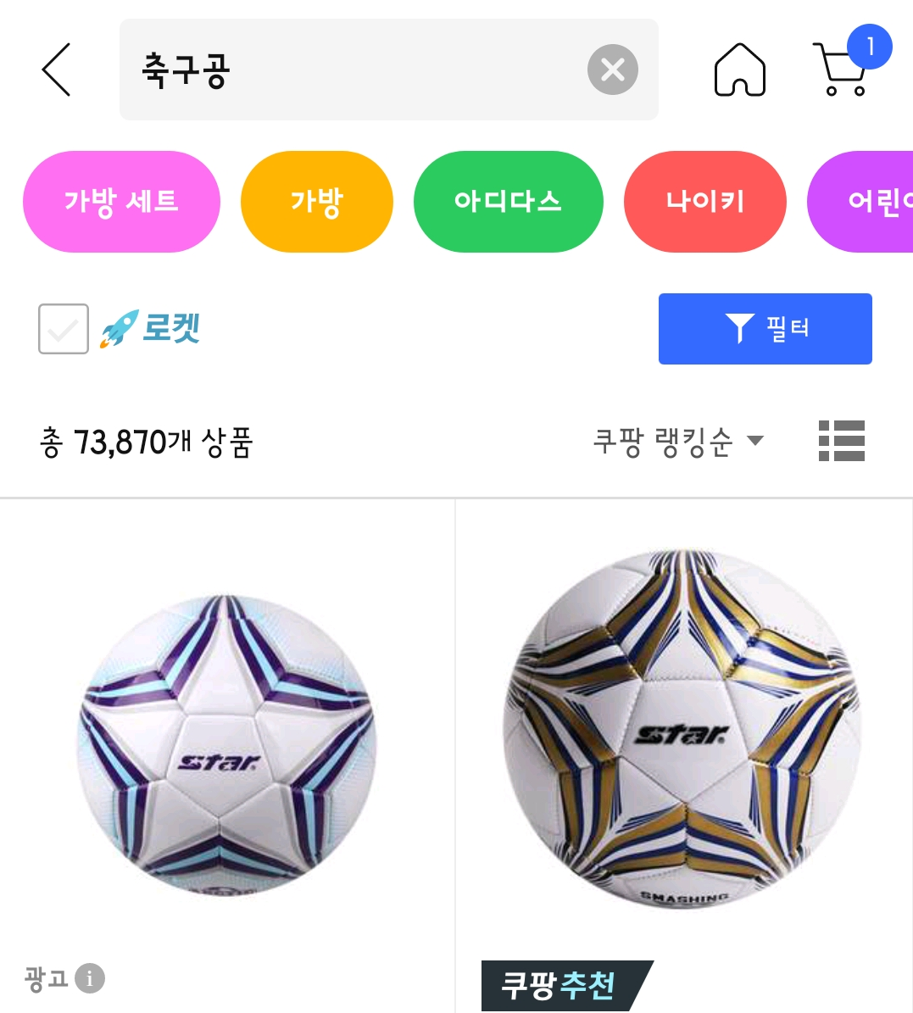
Social Commerce
Hard to decide
Over 600,000 product for keyword “스마트워치”
Too many products
Over 70,000 product for keyword “축구공”

Slide 5
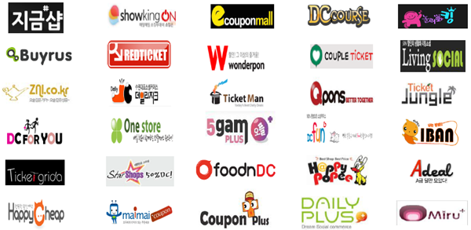
Too Many Sites
Hard to decide which one is the best

Slide 6



We want
to make it
Providing Various
Category
Easy to Compare
Help you to
Decide

Slide 7
#02
Project
Overview

Slide 8
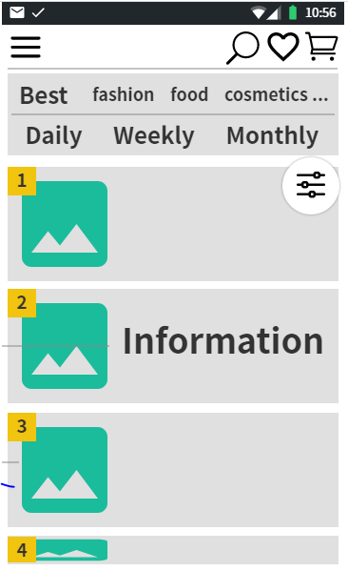
We want to provide various rankings by various options
For example by categories or by period

Slide 9
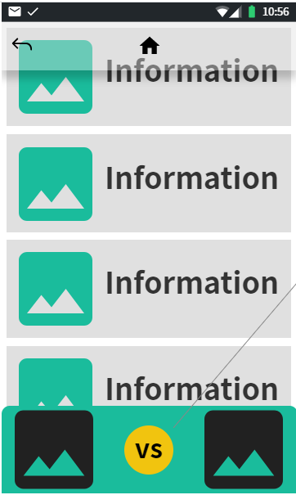
We want to display more comparable data for the products
We want to introduce a special function to help customers to compare various products

Slide 10
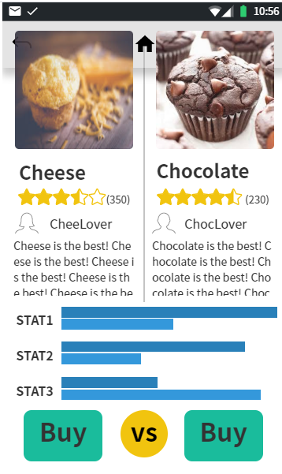
We want to provide a special window for comparing products
We want to provide many comparable data in an easy understandable display to help customers decisions

Slide 11
#03
Development
Plans

Slide 12



Project Plan
By using the incremental model
Requirement Engineering
~Week 9
Design & Evaluation And Integration
~Week 13
Test & Review
~Final Presentation

Slide 13
#04
Expected
Benefits

Slide 14

Easier to Compare
Products
Higher Satisfaction
Higher Visibility
For Comparing
Easier to Decide

Slide 15
#05
References

